Slide 1
NYLSTROOM PRIMARY SCHOOL
PRESENTER : MALEBALA CHUEU
PROVINCE : LIMPOPO
DISTRICT : WATERBERG
CIRCUIT : NYLSTROOM
SCHOOL : NYLSTROOM PRIMARY

Slide 2
THE IMPACT OF INVASIVE ALIEN PLANTS ON PEOPLE’S LIFES
What are invasive alien plants
Foreign
Easily spread
Huge
Notes:
NYLSTROOM PRIMARY

Slide 3
SCHOOL MAP

Slide 4
IDENTIFICATION OF IAP’S
CLUSTER
BROAD LEAVES
HUGE

Slide 5
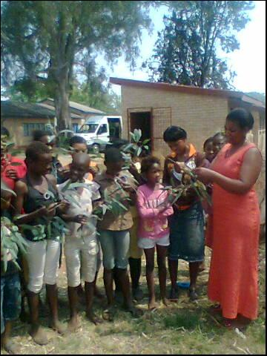
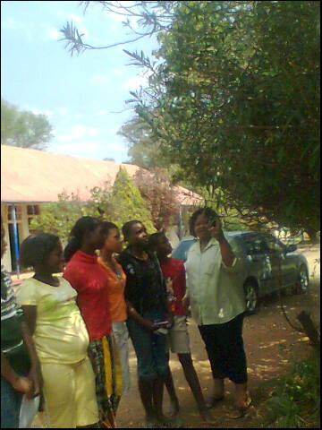
IDENTIFICATON OF IAP’S

Slide 6
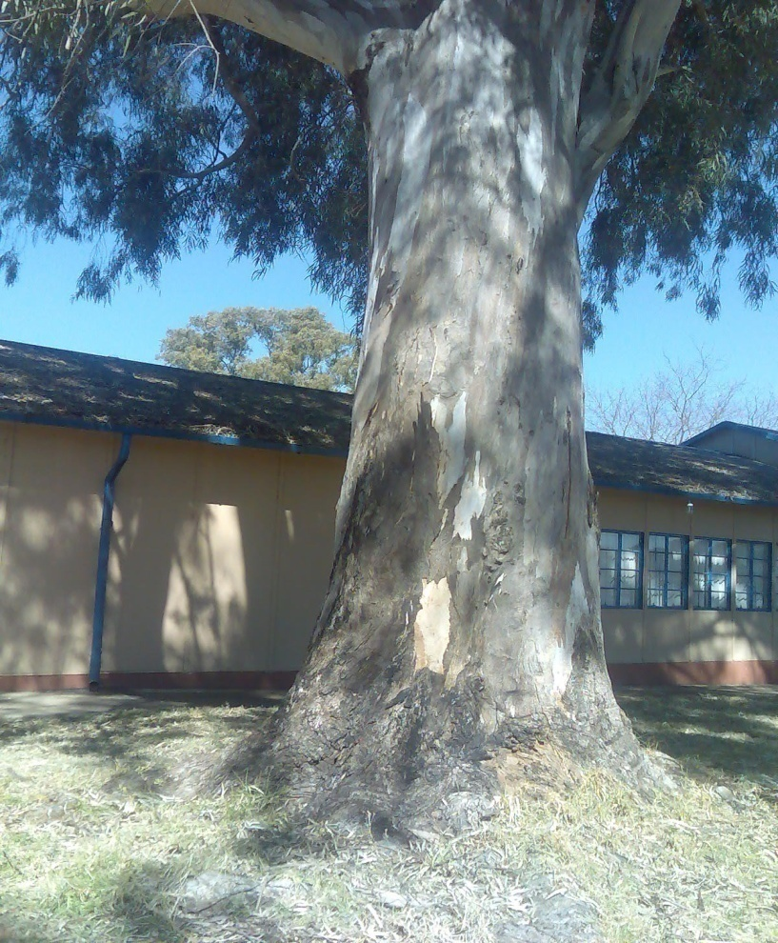
RED RIVER GUM
IMPACT
Hall , toilets and kitchen
Drainage
Bore hole
Mabala’s cottage
Other indigenous plants
Storeroom

Slide 7
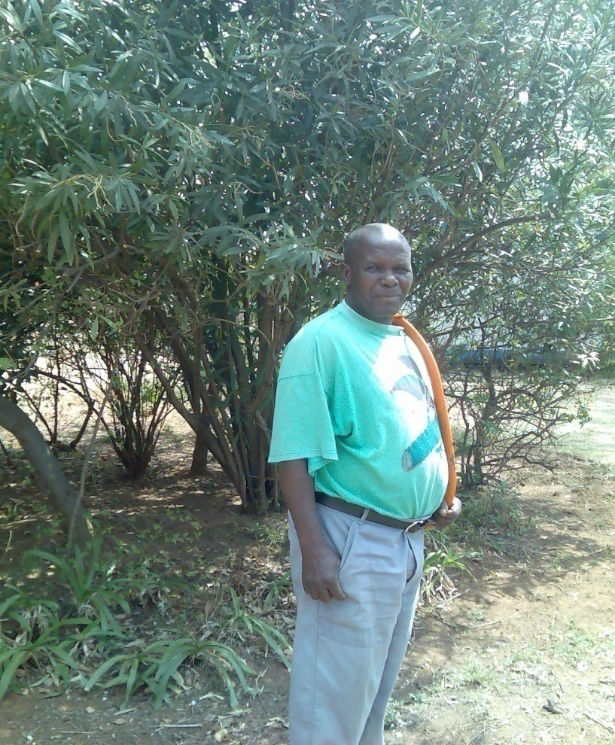
Case study
  MABALA THE HANDY MAN
Worked since 1996 (13years)
Planted in row as wind breakers
Huge tree for shade over the hall
Multiplied in numbers
Dangerous to him

Slide 8
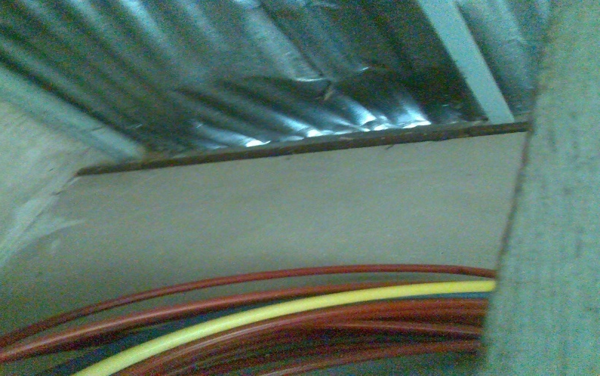
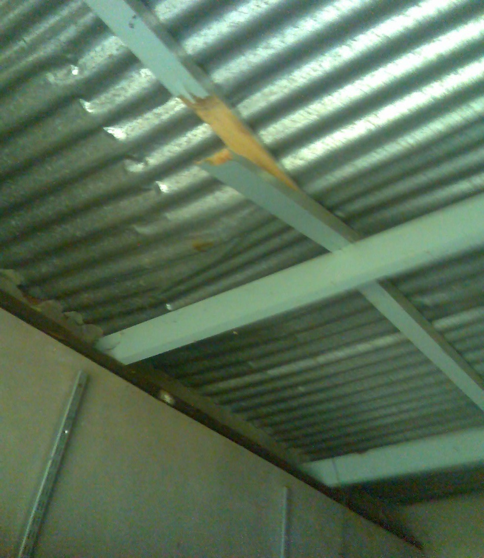
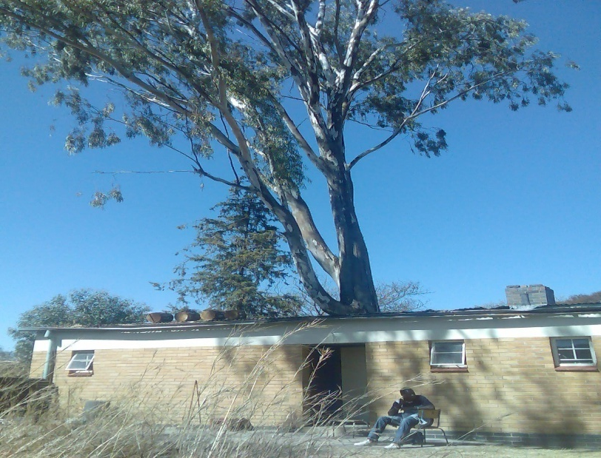
IMPACTS ON MABALA’ S COTTAGE

Slide 9
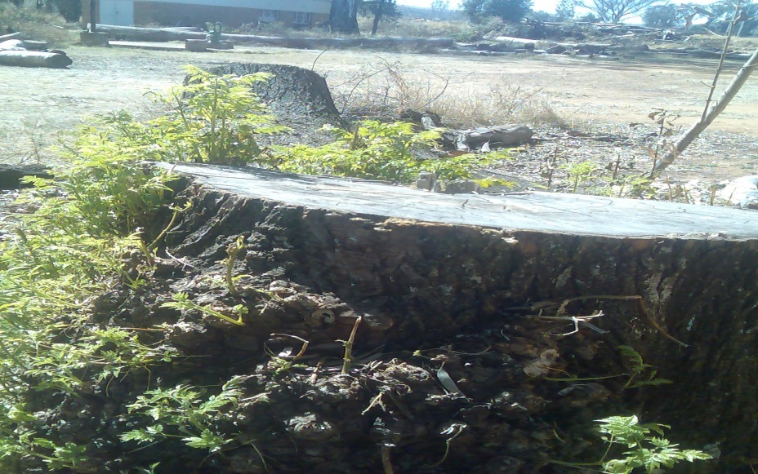
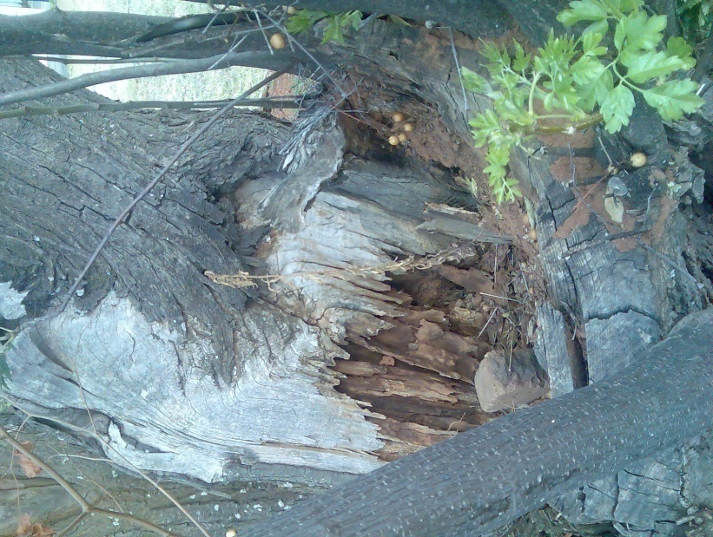
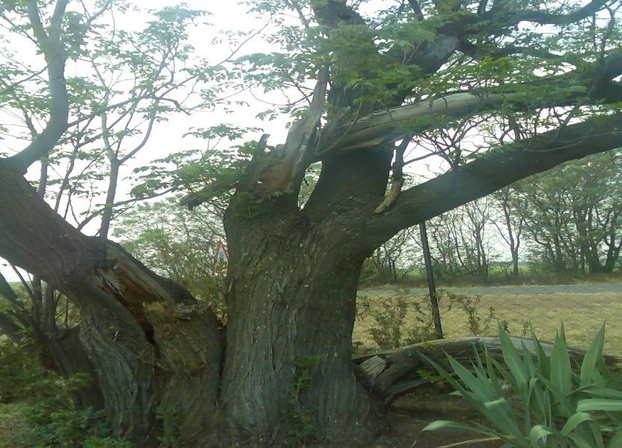
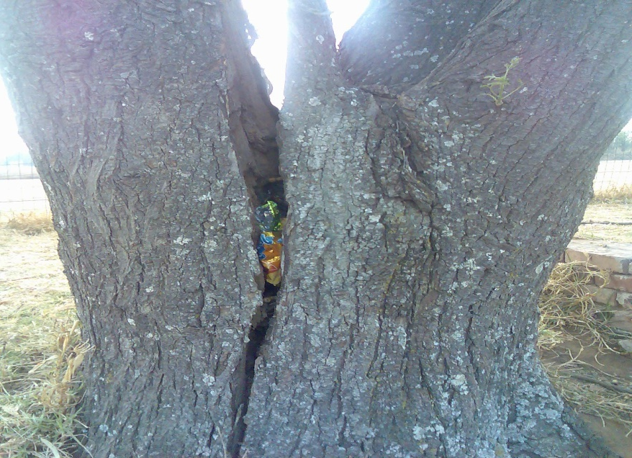
SYRINGA

Slide 10
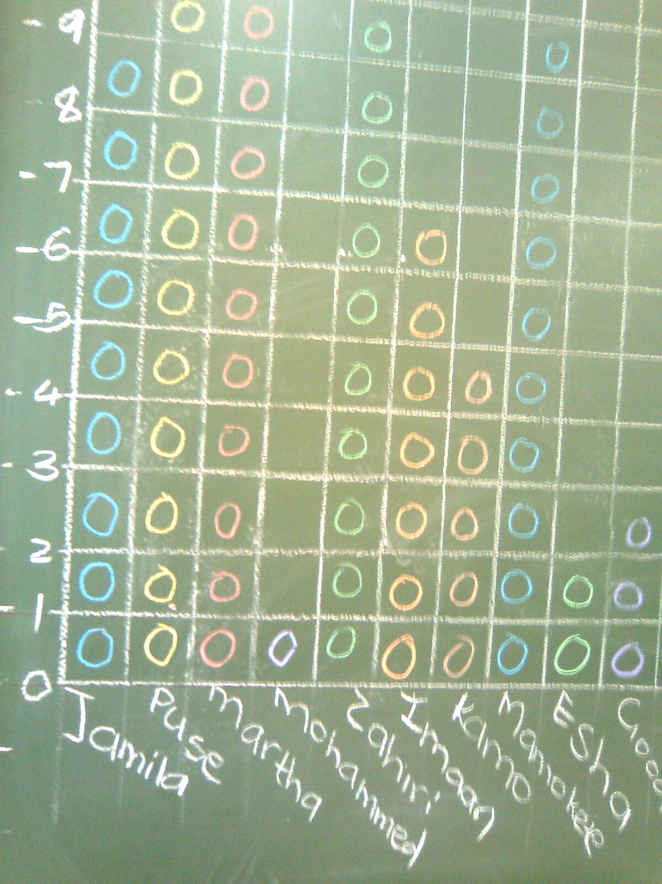
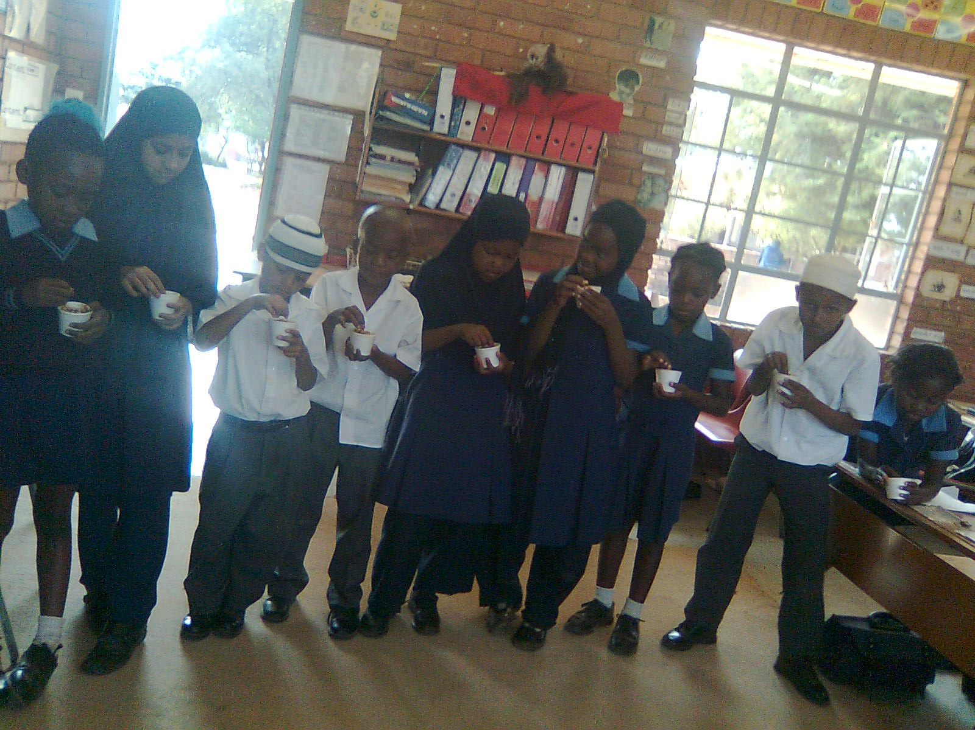
INTERGRATION WITH CURRICULUM
MATHS LO5

Slide 11
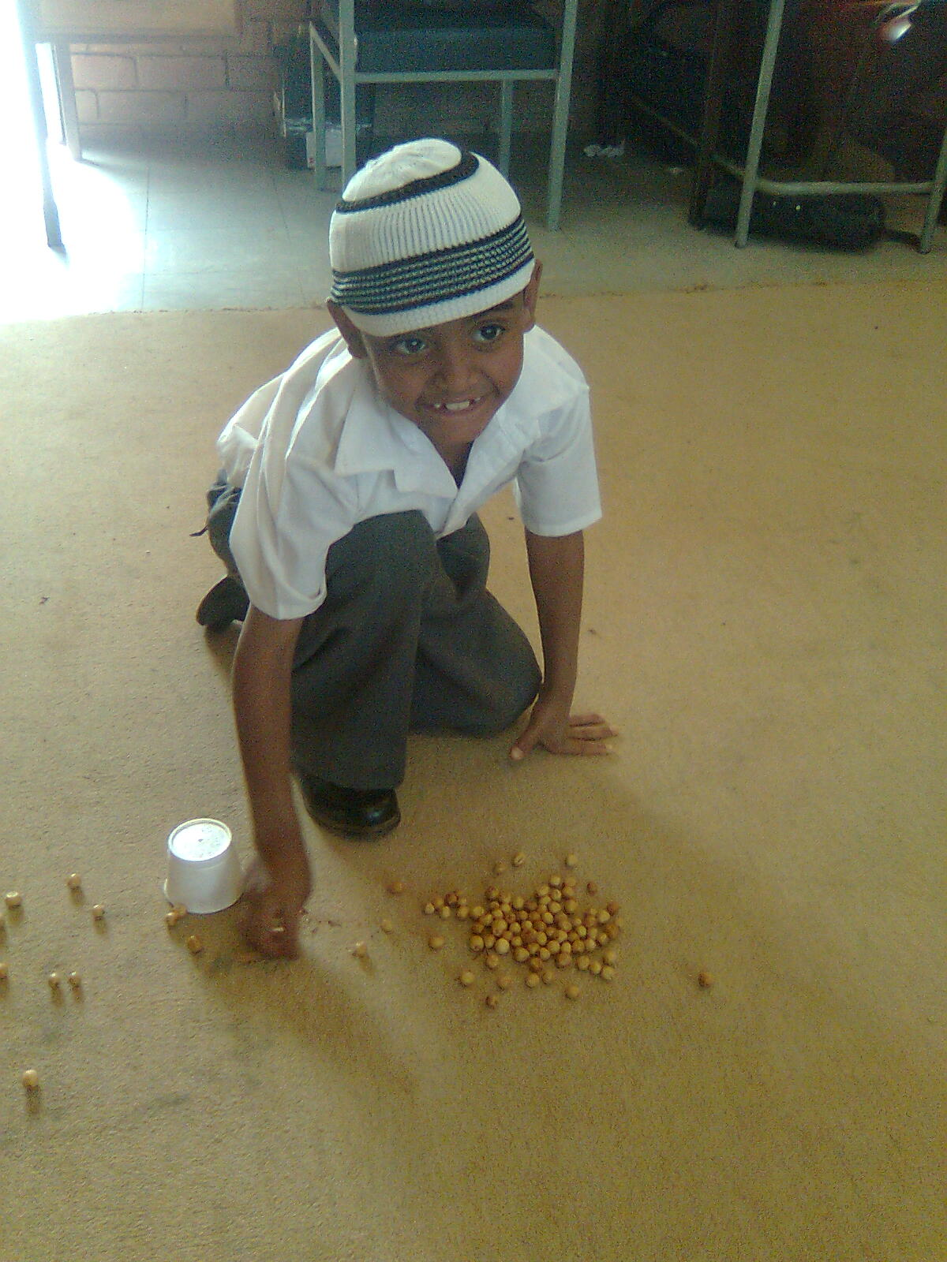
CURRICULUM
MATHS LO 1
MATHS LO 1

Slide 12
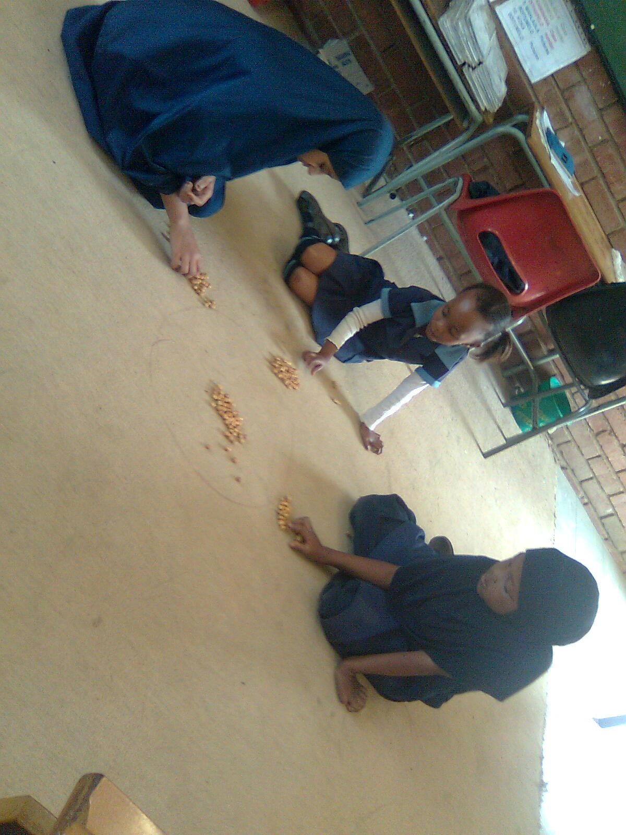
CURRICULUM
LO LO 4

Slide 13
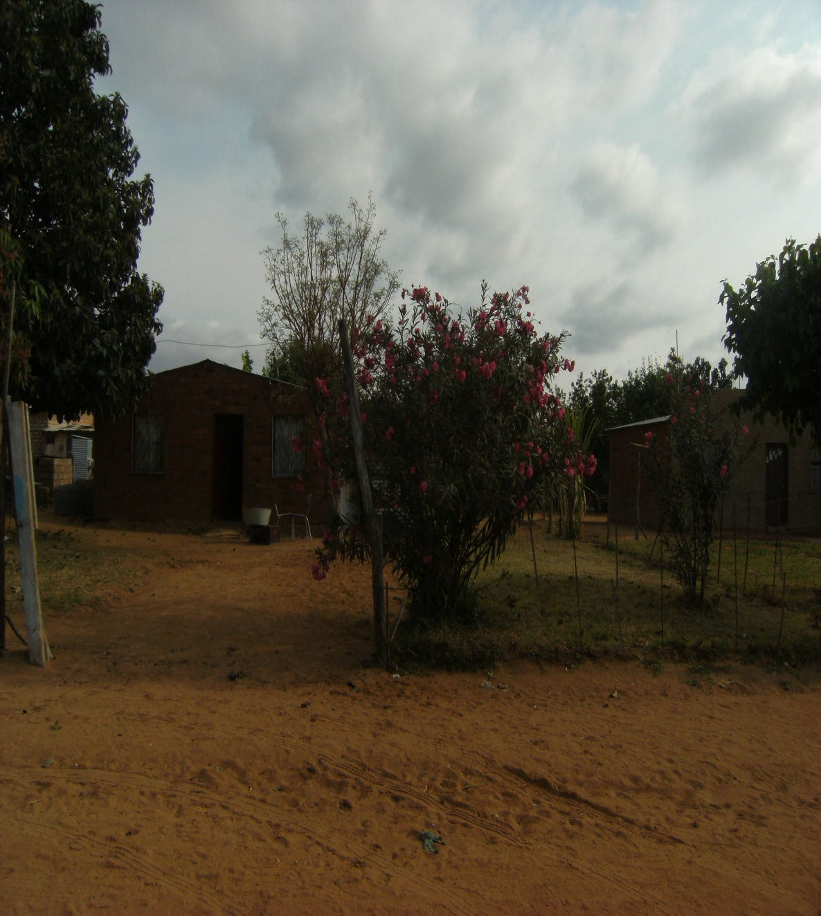
OLEANDER
IMPACT
POISONOUS
Leaves
Flowers
Sticks

Slide 14
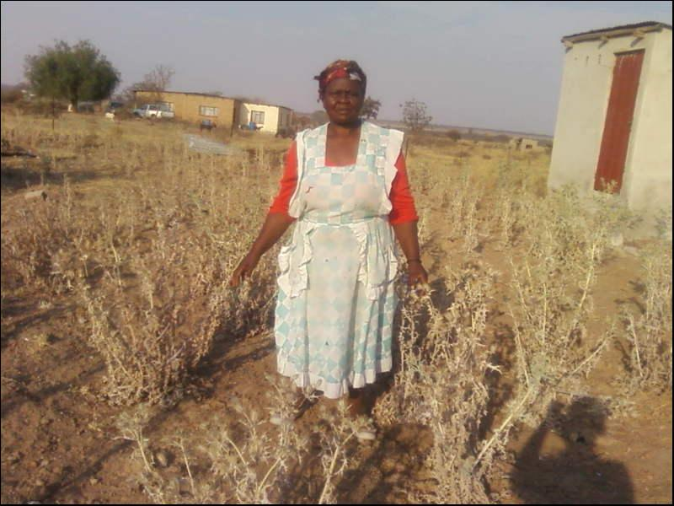
COMMUNITY AWARENESS
MEXICAN POPPY
CASE STUDY (MATILDA MODIBA )
Small rural farmer
Maize, beans, groundnuts
Control
Hoe
pulling out
        IMPACT
Regrows
Spreads even more ( reduce available land for cultivation )
Compete with crops for water (low & poor harvest)
Advice
Using of chemicals
Engaging dwa

Slide 15
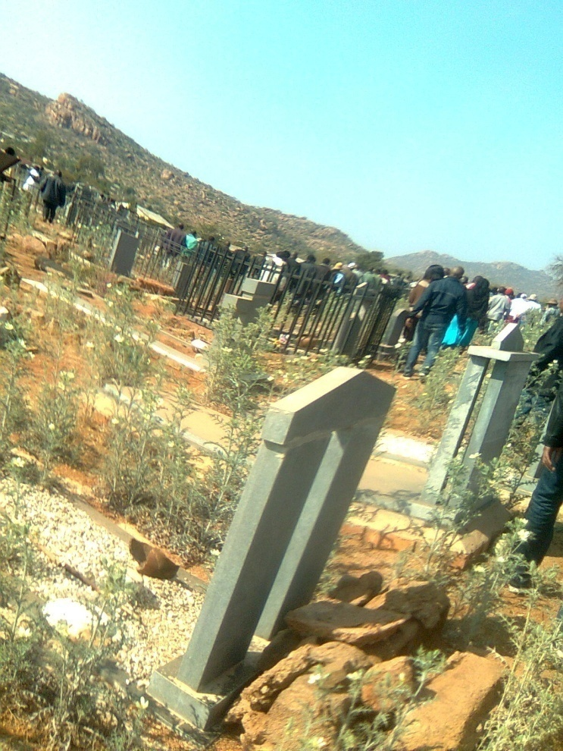
MORE ABOUT MEXICAN POPPY
Cemetery Masemola
( Sekhukhune)

Slide 16
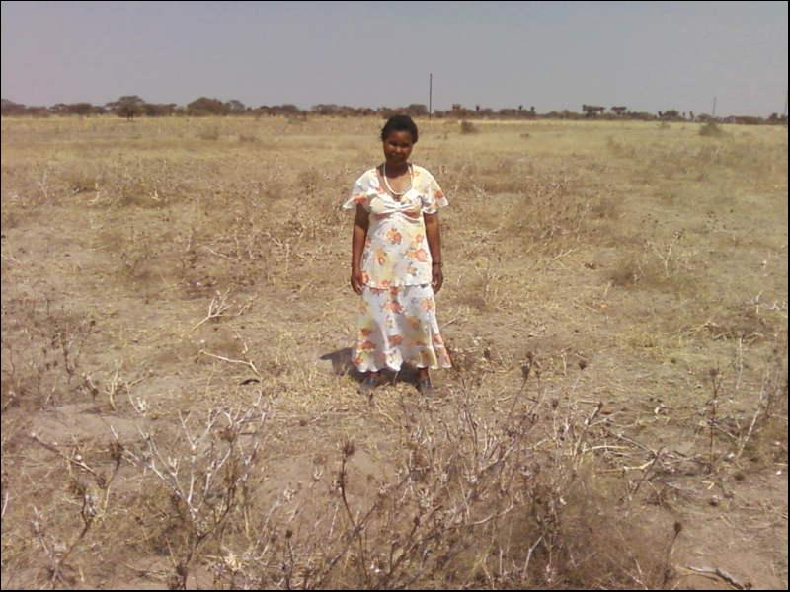
THORN APPLE
Case study (Dina Phukubje) small rural farmer
Same problem as Mexican poppy but also poisonous
Problem even during harvesting

Slide 17
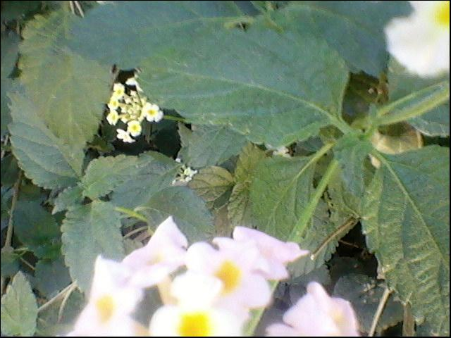
LANTANA CAMARA
Case study (Mr. Prinsloo) commercial farmer (cattle )
Impact
Economical
Psychological
Social

Slide 18
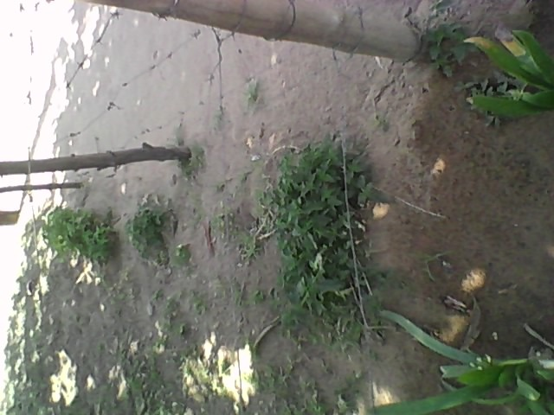
OUTCOMES
1. Working for water helped.
Awareness spread to other people.
Some started eradication.

Slide 19
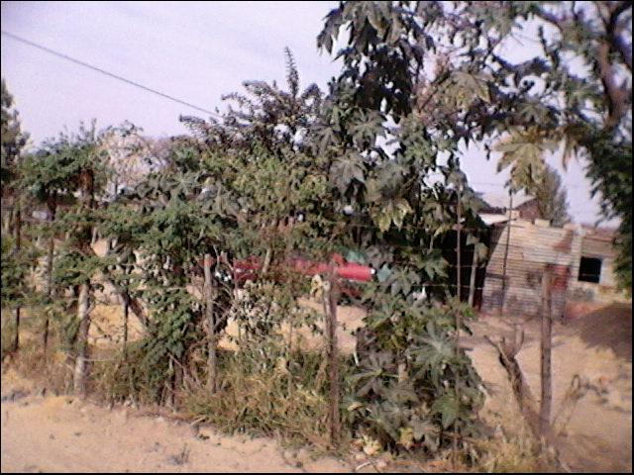
CASTER OIL PLANT
Case study
Christinah Mokgola (Ex Traditional Healer Helper )
Impact
Poisonous
Useful
Menstrual pain reliever
Swollen body parts soother
Advise : No further planting and advise clients not to eat .

Slide 20
Modimolle
      IAP’S
Yellow bells , Guava , lantana , mulberry & orchid
Awareness
Need to address the community
Churches
Funerals
Community meetings
To stop further planting &control spreading.

Slide 21
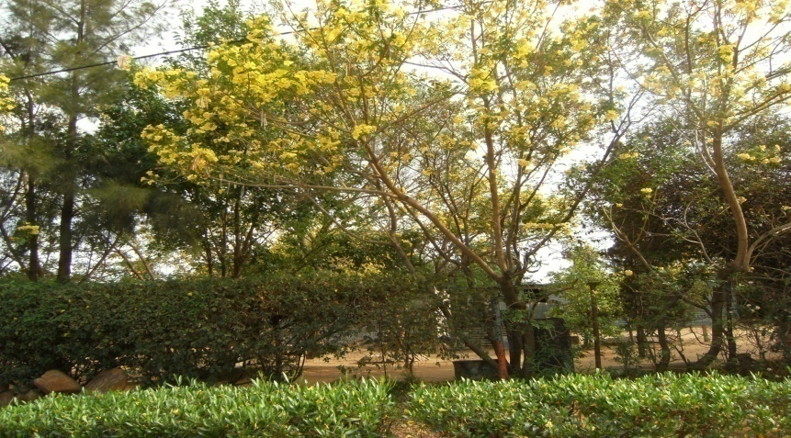
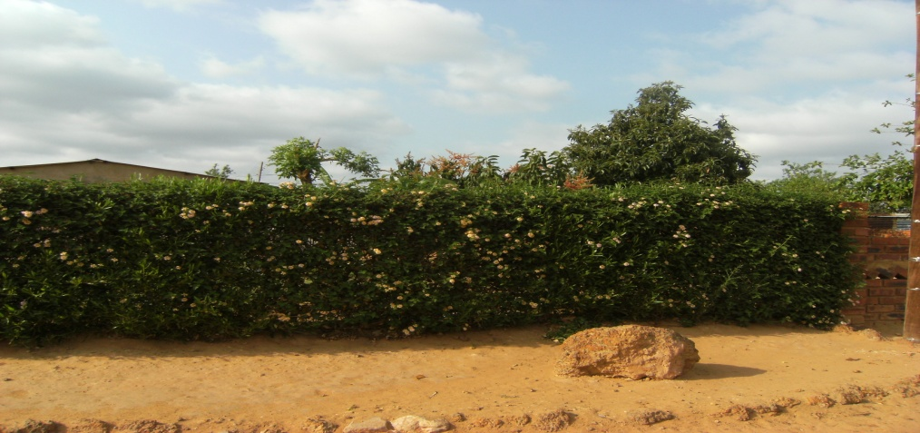
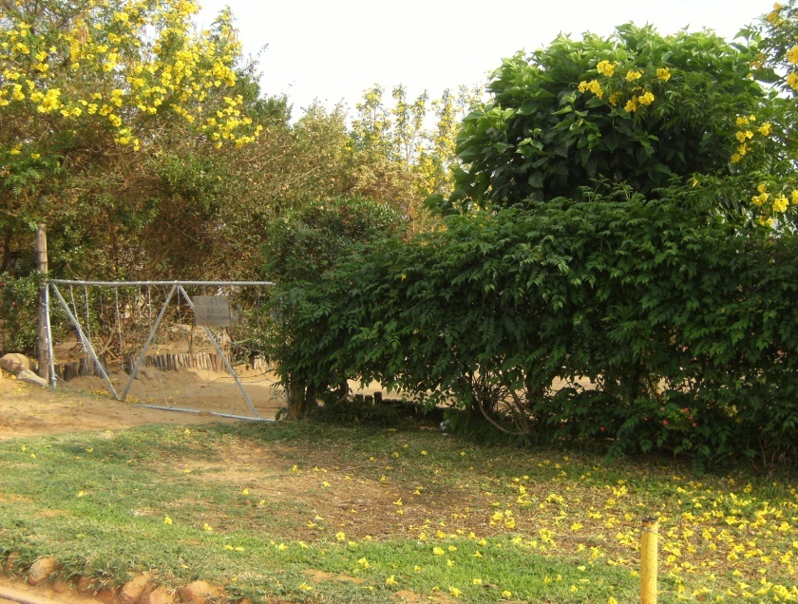
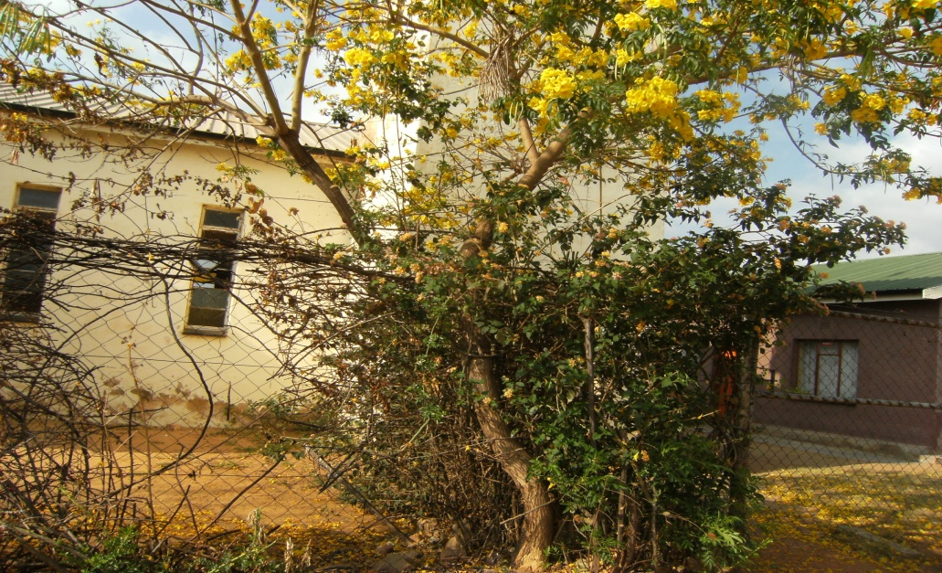
IAP’S IN MODIMOLLE

Slide 22
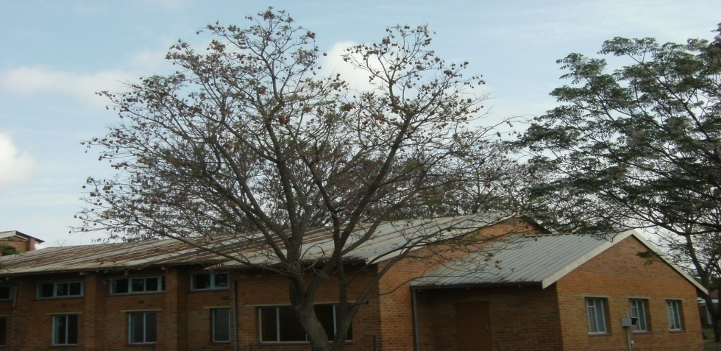
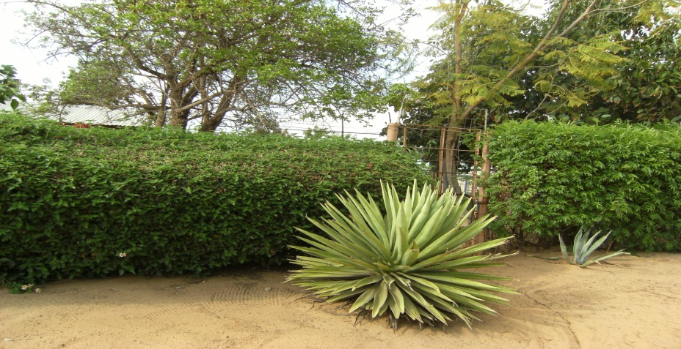
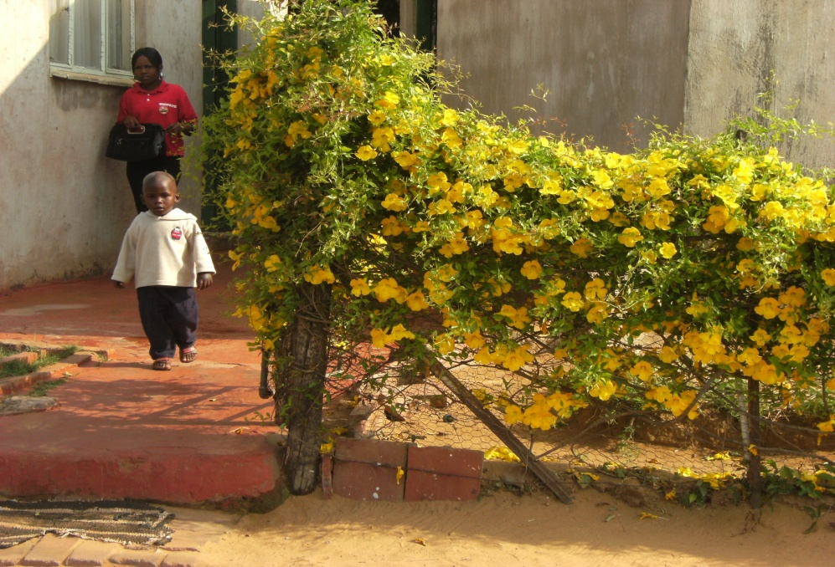
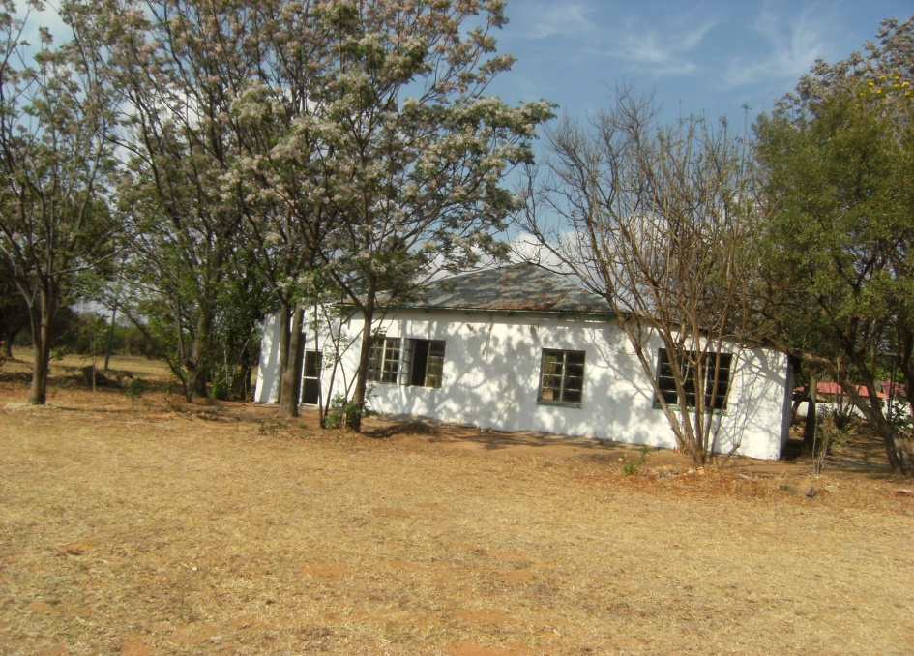
MORE

Slide 23
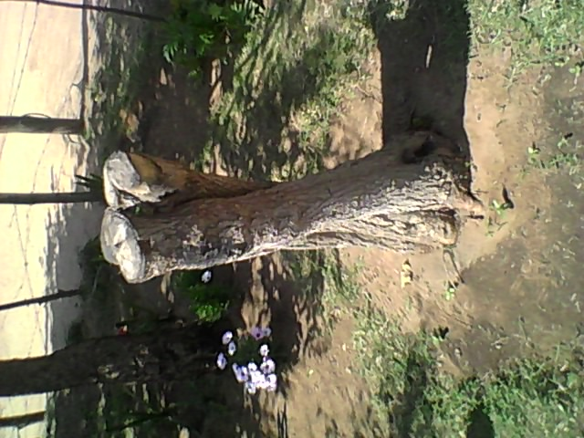
Positive outcomes
1.willingness to
eradicate.

Slide 24
EVIDENCE

Slide 25
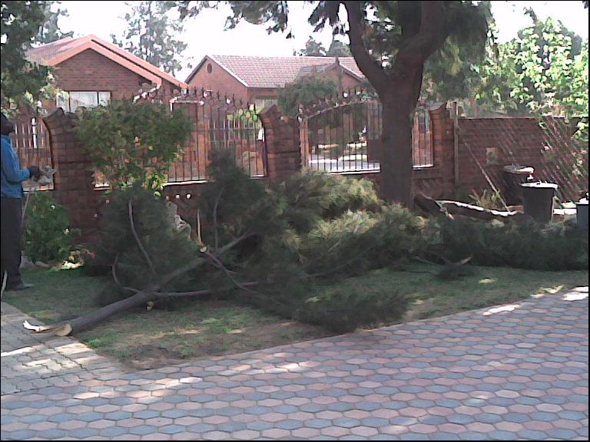
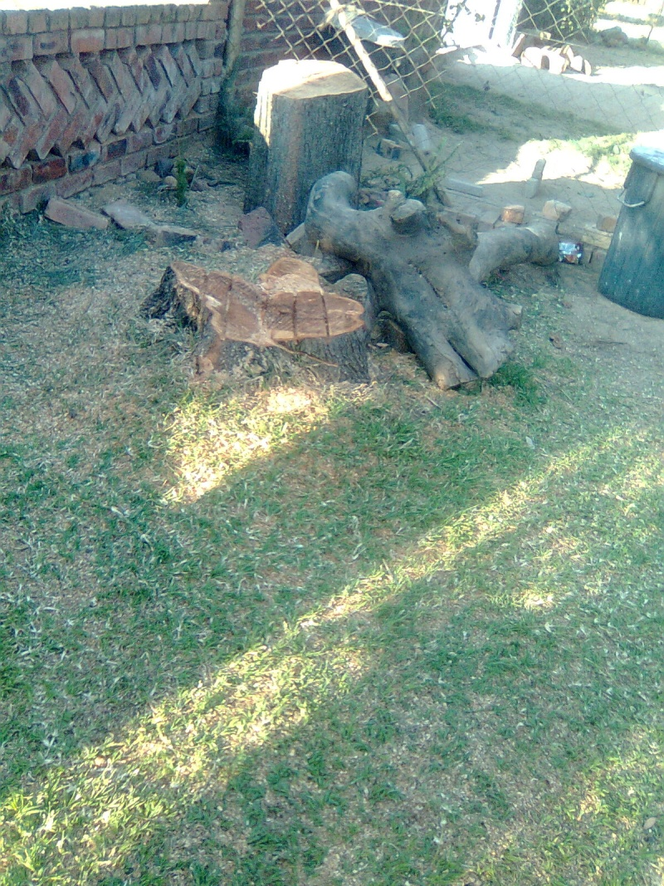
MORE EVIDENCE

Slide 26
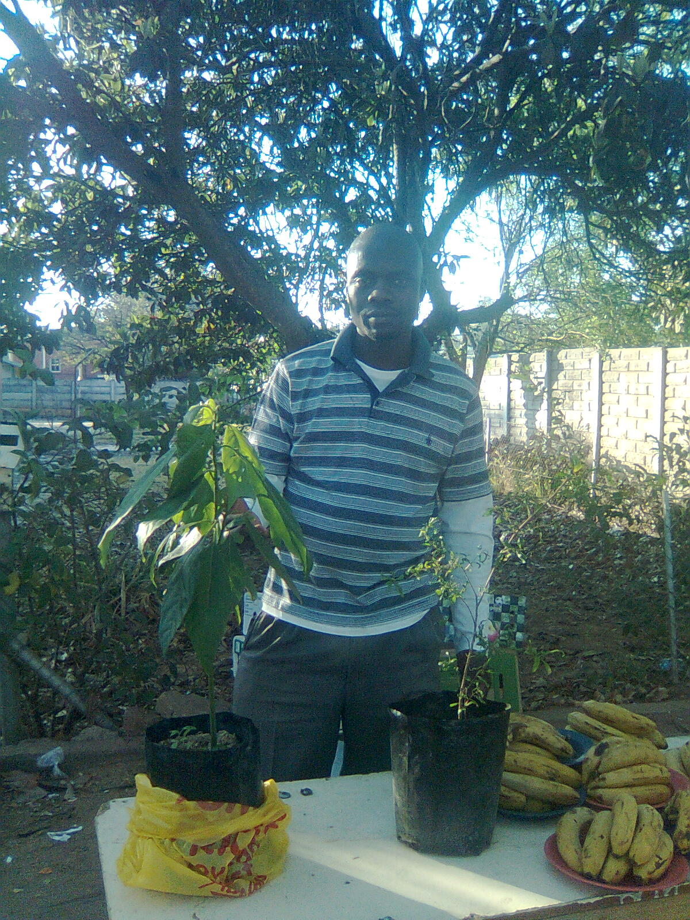
MORE EVIDENCE
Street hawker

Slide 27
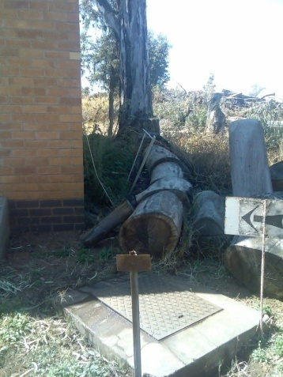
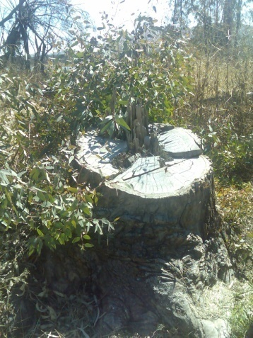
CHALLENGES
Economical
Insufficient method used. ( mechanical) due to lack of funds.
3. Contradictions
2. Social
Aggressiveness
Resistance

Slide 28
Suggestions
Community co-ordinators from water affairs.
Flyers at places where most people visit.eg post office, police stations etc.
Broadcast during weed buster week on media.eg radio stations.

Slide 29
Conclusion
IAP’S AFFECT OUR LIVES NEGATIVELY.
SOUTH AFRICA IS A SCARCE WATER COUNTRY
LETS JOIN HANDS & CONTROL IAP’S TO PROTECT OUR NATURAL RESOURCES.
GO & SPREAD THE MASSAGE TO ALL SOUTH AFRICANS
Notes:
NYLSTROOM PRIMARY SCHOOL

Slide 30
OTHER INFORMATION
Indringerplante (Mooi Maar Gevaarlik) , 1978, GH Stirton, Department Of Nature & Conservation.
Alien Weeds & Invasive Plants , 2001, Lesly Henderson. ARC. LNR
DWA( Working For Water)
Department Of Agriculture

